Slide 1
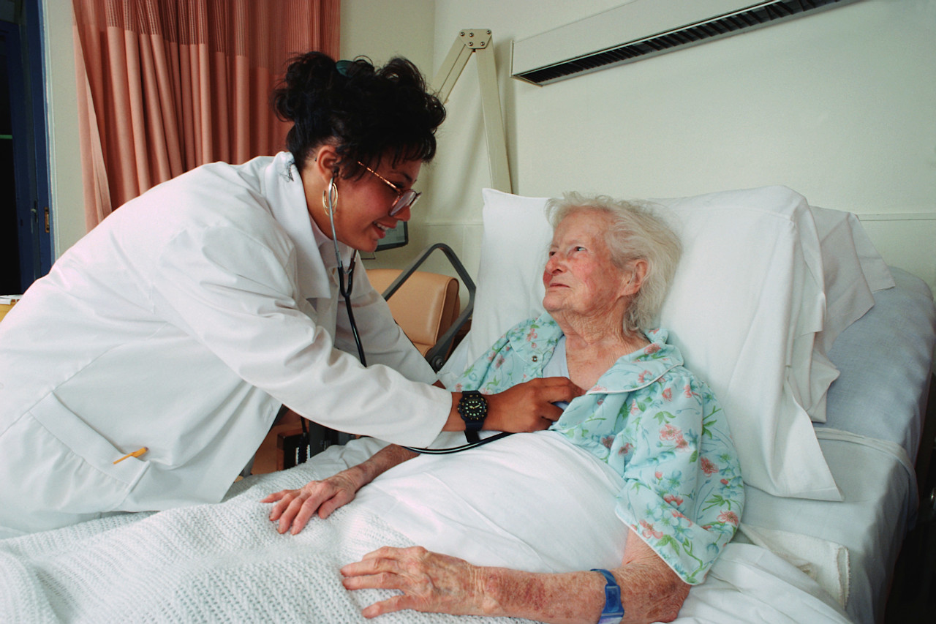
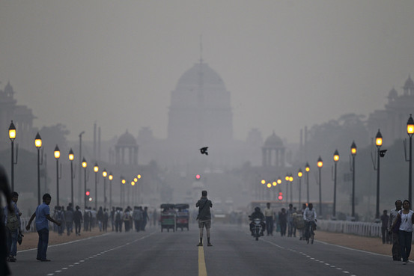
AIR QUALITY MONITORING SYSTEM
Submitted By:
Riju Tejas Singh(2019UCO1572)
Vishal Verma(2019UCO1563)
Rijul Garg(2019UCO1570)

Slide 2
Problem statement
Nowadays cities specially like metropolitan cities are now facing one of the most serious problem i.e. Pollution.
Indian cities are the one of the most polluted cities in the world.

Slide 3
Motivation and objective
Air pollution causes a lot of harm to our surroundings and also causes a lot of health problems to people around us. These health problems include breathing diseases like asthma, chronic obstructive pulmonary disease, chronic bronchitis, emphysema etc.
Neglecting air pollution may cause various kinds of problems to us which include more hospital admissions, premature death, lung problems which may even include lung cancer, breathing problems, wheezing, coughing, and worsening of existing cardiac conditions and respiratory conditions.
Our motivation is to focus on serious problems like gas leaks and other hazards like explosion of flammable gases, chemical burns, cold burns and poisoning.

Slide 4
Our solution
So we are trying to make an IOT based air pollution monitoring system, which main aim is to monitor the air pollution which will be beneficial for the people who had some lung disease aur facing the lung and heart issues.
We created a Web and mobile based application which will notify the user when any of the reading like PM 2.5, Carbon Monoxide and LPG gas.

Slide 5
target audience
People’s health risk from air pollution varies widely depending on age, where they live, their underlying health, and other factors. Many studies show that people with lower socio-economic status and minority populations are disproportionately exposed to air pollution and are more vulnerable to adverse health impacts. Data from the Minnesota Department of Health (MDH) show disparities in heart and lung disease by age, race/ethnicity, income level, and geography.

Slide 6
Customer audience
Populations most at risk of health problems related to air pollution:
People with lung diseases, such as asthma, chronic bronchitis, emphysema, and chronic obstructive pulmonary disease
Infants and young children
People who work or exercise outdoors
Adults over 65 People with a cardiovascular disease
people who lack access to health care
People who smoke or are exposed to second-hand smoke
People working in occupations where there is high exposure to contaminated air
People who spend a lot of time near busy roadways

Slide 7
implementation
This project provides a combination of process of sensing several gas levels in the air and also the ambient temperature and humidity, thus sensing the quality of the air.
The levels of the gases and the temperature is displayed in a LCD display panel as well as on the mobile and the laptop screen, which continuously shows the real time output values of all the gas sensors , temperature and humidity sensor.

Slide 8
Process flow
Mobile App
Mobile App
Mobile App
Hardware
Wi-Fi
Cloud
Household
Desktop View
Database

Slide 9
WORKING OF OUR PROJECT
Arduino is a single-board microcontroller meant to make the application more accessible which are interactive objects and its surroundings.
The MQ-5 sensor can detect or measure gases like LPG ,Alcohol, Propane, Hydrogen and even Methane.
Wi-Fi connects the whole process to the internet and LCD is used for the visual output. The air monitoring system overcomes the problem of the highly-polluted areas which is a major issue.
A danger signal is raised as soon as the air pollution level exceeds safety mark.
This system has features for people to monitor amount of air pollution using this application. We have proposed an air quality and pollution monitoring system that allows us to monitor and check live air quality and pollution through IOT system, has used air sensors to sense presence of harmful gases and compounds in the air and constantly transmit this data.
The sensors react with Arduino uno which processes the data and transmits it over application. This shows authorities to monitor air pollution in different areas and act against it.

Slide 10
Hardware used
Arduino UNO
16X2 LCD Panel
Temperature and Humidity sensor (DHT 11)
Air Quality Sensor PM 2.5 (MQ 135)
Carbon Monoxide Sensor( MQ 7)
LPG Gas Detection Sensor( MQ 5)
Wi-Fi Module( ESP8266)
Potentiometer
Jumper Wires

Slide 11
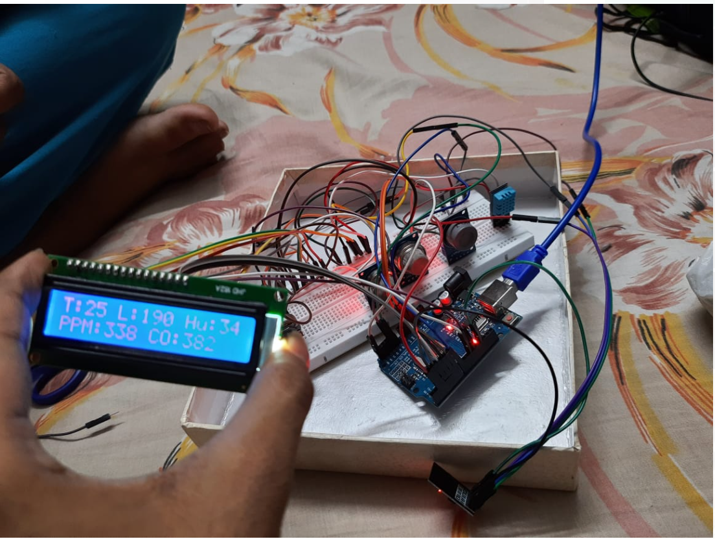
OUR HARDWARE
MQ 135
DHT 11
MQ 7
LCD
Arduino UNO
MQ 5
ESP 8266

Slide 12
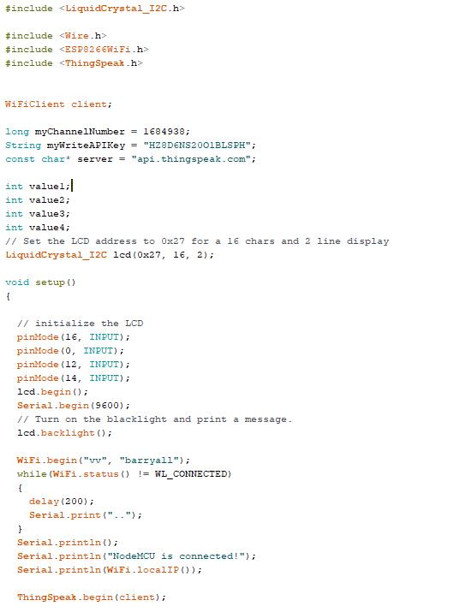
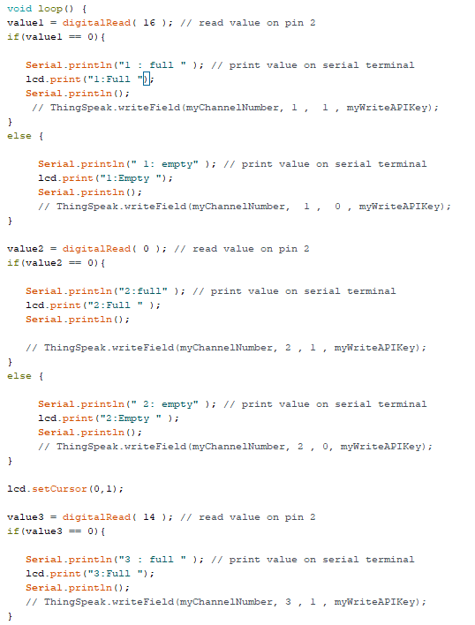
Arduino code

Slide 13
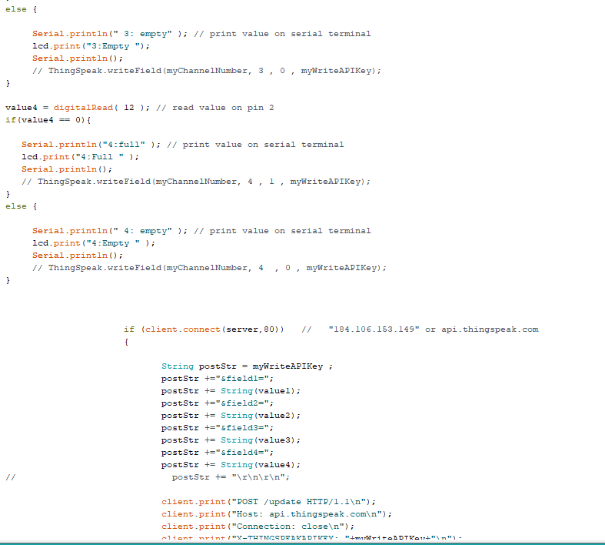
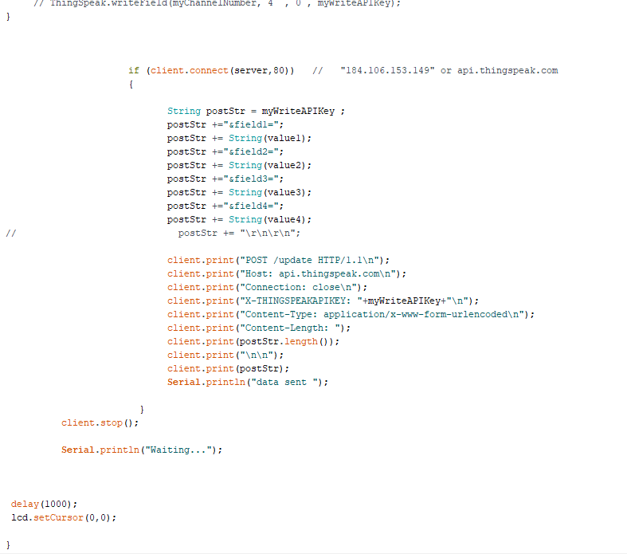
ARDUINO CODE

Slide 14
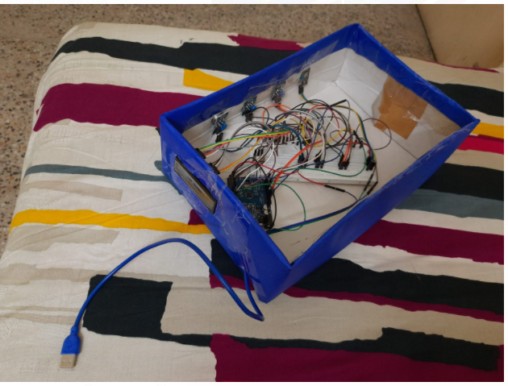
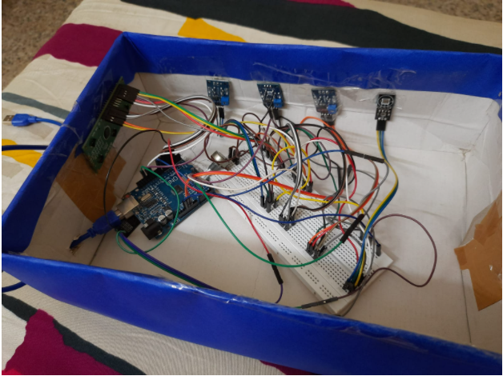
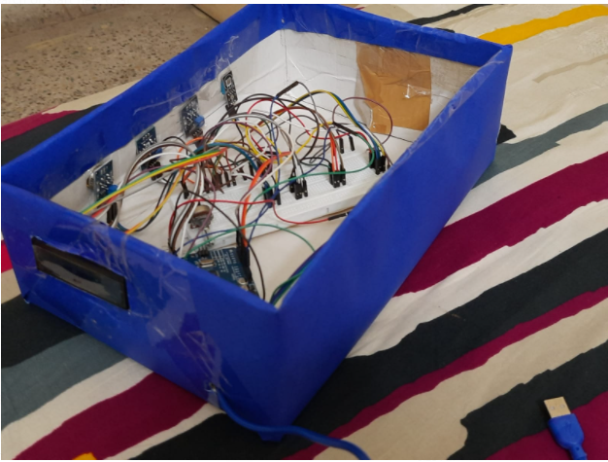
Our industry prototype

Slide 15
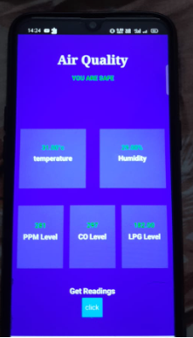
MOBILE application
THE APP IS BUILt using MIT APP INVENTOR
This app is notifying the user that your house is safe and all the gases are below their threshold value

Slide 16
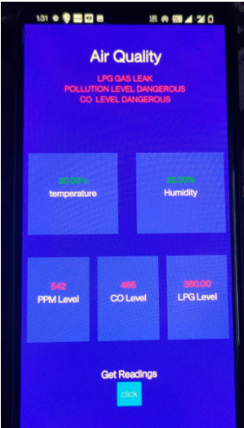
MOBILE APPLICATION
ALERTING the USER VIA MOBILE APP
Now the app is notifying the user that your house is NOT safe and all the gases are EXCEDING their threshold value

Slide 17
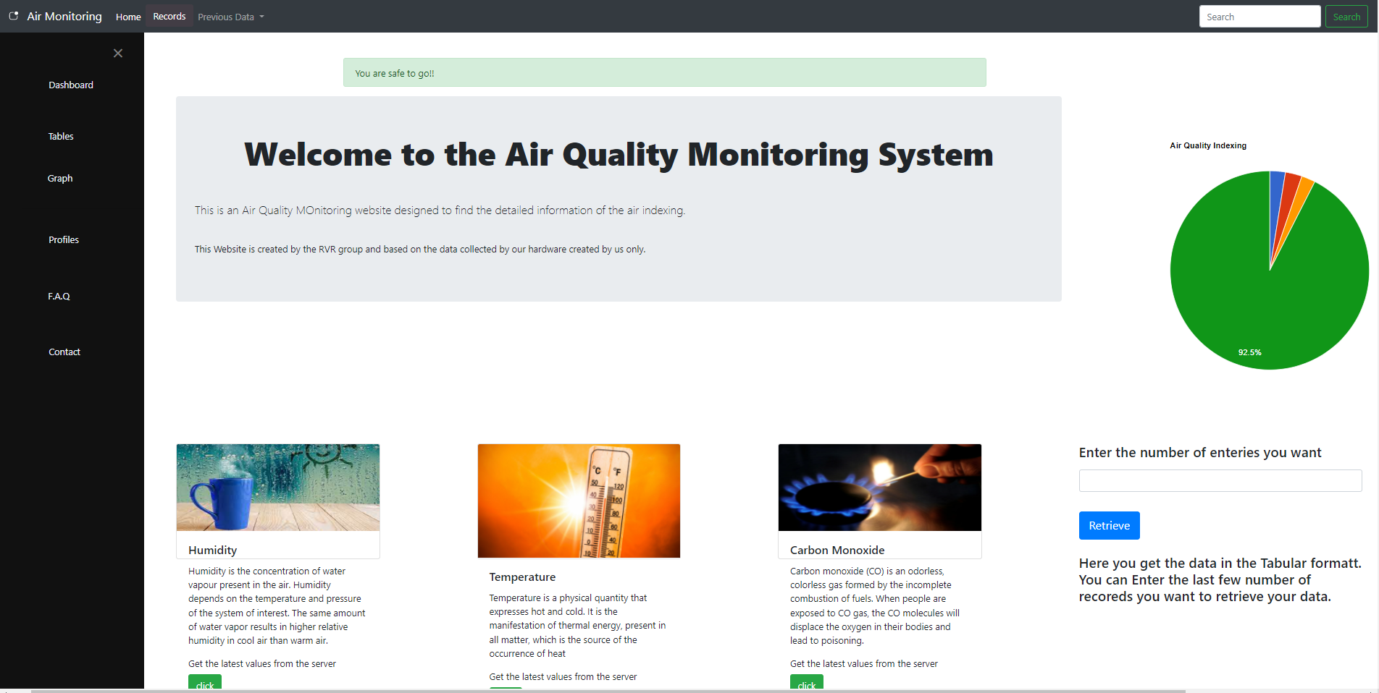
WEB APPLICATION

Slide 18
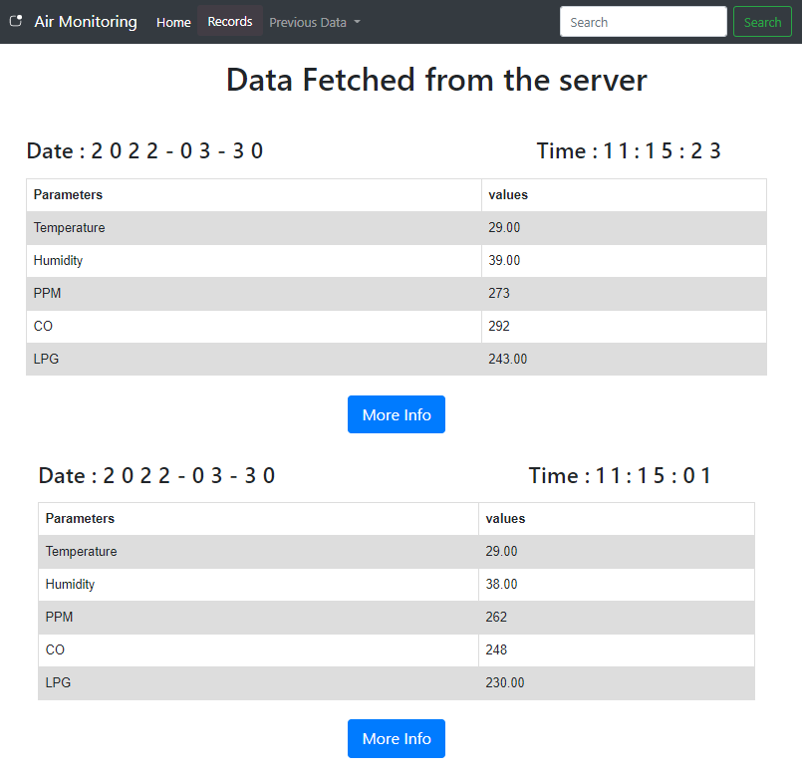
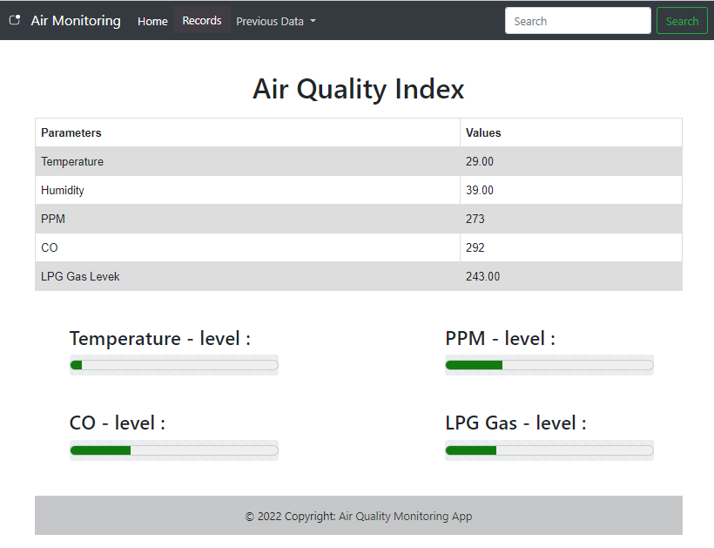
Data visualization on web APP
Redirecting

Slide 19
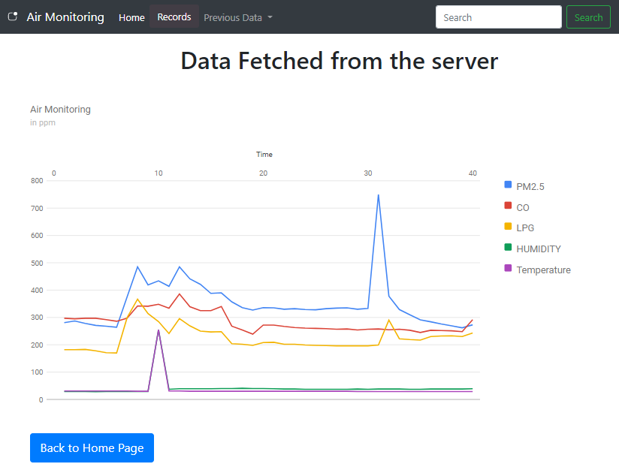
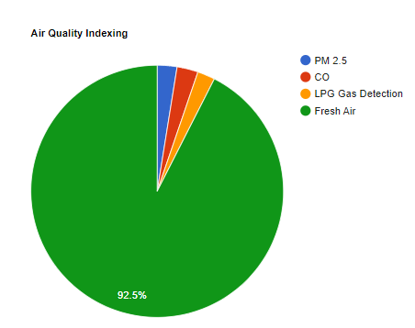
GRAPHICAL REPRESENTATION OF THE PREVIOUS DATA

Slide 20
DEMONSTRATION VIDEO

Slide 21
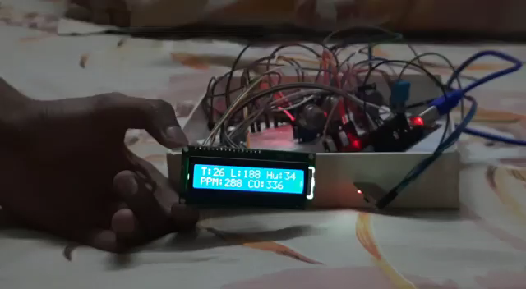

Slide 22
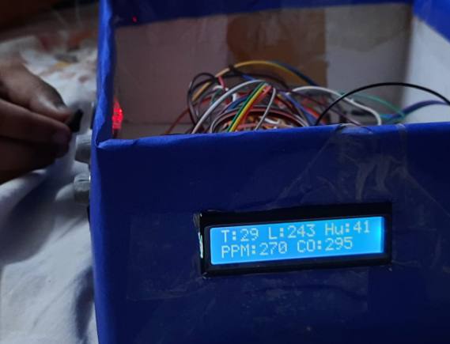
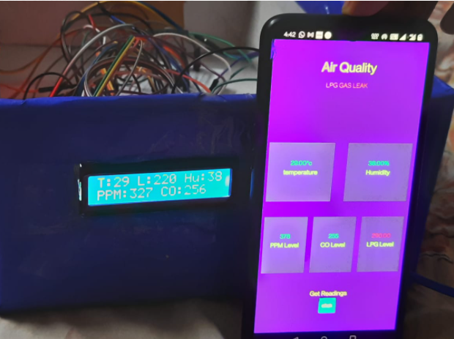
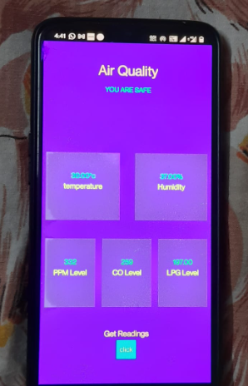
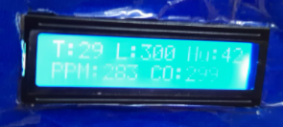
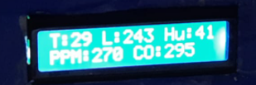
WORKING OF OUR PROTOTYPE

Slide 23
CHALLENGES
Hardware should be close to the gas leakage prone area
Real Time Updation of Data
Internet Connectivity
Size of the box

Slide 24
Contribution towards society
This IOT based air quality monitoring system will make people more aware about their surroundings. People can avoid hazards, accidents and various types of illnesses by easily accessing the various air quality parameters in their nearby surroundings.
Help can be provided to workers who are working in tough environmental conditions by the concerned authorities.
This can be achieved by keeping real-time control on aur IOT based solution. Air monitoring can be made easier through effective SMS alerts and Detection of toxic gases can be made much easier.
The monitoring of temperature and humidity can be helpful in the analysis of required situation and can be helpful to keep a favorable environment, particularly in the field of mining.

Slide 25
advantages
Cost Efficient
Users from all type of domain can easily monitor their home pollution level with minimum effort.
Our project was designed to help a person to detect, monitor, and test air pollution in a given area. The kit has been integrated with a mobile application that helps the user in predicting the pollution level of their entire route.
This proposed air pollution monitoring kit along with the integrated mobile and web application can be helpful to people to identify their exposure level to air pollutants.

Slide 26
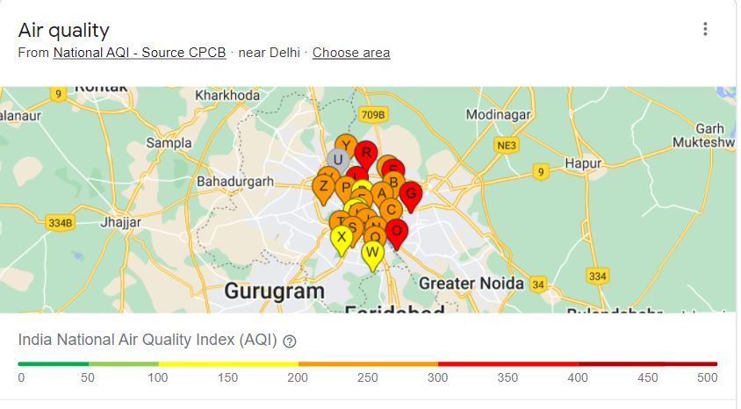
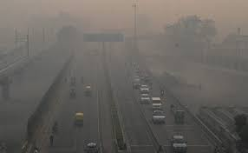
Future scope
Through the help of this prototype, our aim is to expand by planting various such prototypes in as many small localities in Delhi as possible that would help us to cover almost all the regions of Delhi and would help us to get more accurate air quality index results locality wise and help us to react to the extremities of the air quality better.
We can further provide this data for research work which would enable the researchers to perform an even more detailed analysis on air quality

Slide 27


